Slide 1
Introduction to Data Structure
Prepared By: Chandrakanta Sen

Slide 2
Introduction to Data Structure:
Data Structure is a representation of logical relationship existing between individual elements of data. In other words, a data structure defines a way of organizing all data items that considers not only the elements stored but also their relationship to each other. The term data structure is used to describe the way data is stored.
To develop a program of an algorithm we should select an appropriate data structure for that algorithm.
Algorithm + Data structure = Program
What is Data Structure?
A data structure is a way of organizing the data so that it can be used efficiently.
Here, we have used the word efficiently, which in terms of both the space and time.

Slide 3
Advantages of Data structures: The following are the advantages of a data structure:
Efficiency: If the choice of a data structure for implementing a particular ADT is proper, it makes the program very efficient in terms of time and space.
Reusability: The data structure provides reusability means that multiple client programs can use the data structure.
Abstraction: The data structure specified by an ADT also provides the level of abstraction.
Need of Data structures:
Processor speed
Data Search
Multiple requests

Slide 4
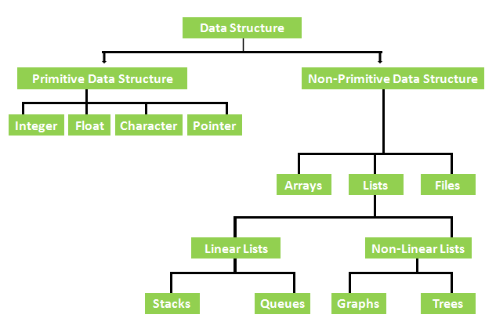
Types of Data Structure

Slide 5
Types of Data Structures:
There are two types of data structures –
Primitive data structure
Non-primitive data structure
Primitive Data Structure: The primitive data structures are primitive data types. The int, char, float, double, and pointer are the primitive data structures that can hold a single value.
Non-Primitive Data Structure: Non-primitive data structures are more complicated data structures and are derived from primitive data structures. They emphasize on grouping same or different data items with relationship between each data item.
The non-primitive data structure is divided into two types -
Linear data structure
Non-linear data structure

Slide 6
Linear Data Structure: The arrangement of data in a sequential manner is known as a linear data structure. The data structures used for this purpose are Arrays, Linked list, Stacks, and Queues.
In these data structures, one element is connected to only one another element in a linear form.
Non – Linear Data Structure: When one element is connected to the 'n' number of elements known as a non-linear data structure. The best example is trees and graphs.
In this case, the elements are arranged in a random manner.
Data Structures can also be classified as:
Static data structure: It is a type of data structure where the size is allocated at the compile time. Therefore, the maximum size is fixed.
Dynamic data structure: It is a type of data structure where the size is allocated at the run time. Therefore, the maximum size is flexible.

Slide 7
The major or the common operations that can be performed on the data structures are:
Searching: We can search for any element in a data structure.
Sorting: We can sort the elements of a data structure either in an ascending or descending order.
Insertion: We can also insert the new element in a data structure.
Updation: We can also update the element, i.e., we can replace the element with another element.
Deletion: We can also perform the delete operation to remove the element from the data structure.

Slide 8
Basic Terminology:
Data: Data can be defined as an elementary value or the collection of values, for example, student's name and its id are the data about the student.
Group Items: Data items which have subordinate data items are called Group item, for example, name of a student can have first name and the last name.
Record: Record can be defined as the collection of various data items, for example, if we talk about the student entity, then its name, address, course and marks can be grouped together to form the record for the student.
File: A File is a collection of various records of one type of entity, for example, if there are 60 employees in the class, then there will be 20 records in the related file where each record contains the data about each employee.

Slide 9
Attribute and Entity: An entity represents the class of certain objects. it contains various attributes. Each attribute represents the particular property of that entity.
Field: Field is a single elementary unit of information representing the attribute of an entity.
What is Data Type? The data type of a value (or variable in some contexts) is an attribute that tells what kind of data that value can have. Data types define particular characteristics of data used in software programs and inform the compilers about predefined attributes required by specific variables or associated data objects.
ADT: An ADT is a set of elements with a collection of well defined operations. The operations can take as operands not only instances of the ADT but other types of operands or instances of other ADTs.
Examples of ADTs include list, stack, queue, set, tree, graph, etc.

Slide 10
Properties of ADT: It is characterized by the following properties -
It exports a type.
It exports a set of operations. This set is called interface.
Operations of the interface are the one and only access mechanism to the type's data structure.
Axioms and pre-conditions define the application domain of the type.
Algorithm: A finite sequence of instructions, each of which has a clear meaning and can be executed with a finite amount of effort in finite time. whatever the input values, an algorithm will definitely terminate after executing a finite number of instructions.
A typical programming task can be divided into two phases:
Problem solving phase: Produce an ordered sequence of steps that describe solution of problem, this sequence of steps is called an algorithm.
Implementation phase: Implement the program in some programming language.

Slide 11
Characteristics of an Algorithm: The following are the characteristics of an algorithm
Input: An algorithm has some input values. We can pass 0 or some input value to an algorithm.
Output: We will get 1 or more output at the end of an algorithm.
Unambiguity: An algorithm should be unambiguous which means that the instructions in an algorithm should be clear and simple.
Finiteness: An algorithm should have finiteness. Here, finiteness means that the algorithm should contain a limited number of instructions, i.e., the instructions should be countable.
Effectiveness: An algorithm should be effective as each instruction in an algorithm affects the overall process.
Language independent: An algorithm must be language-independent so that the instructions in an algorithm can be implemented in any of the languages with the same output.

Slide 12
Dataflow of an Algorithm:
Problem: A problem can be a real-world problem or any instance from the real-world problem for which we need to create a program or the set of instructions. The set of instructions is known as an algorithm.
Algorithm: An algorithm will be designed for a problem which is a step by step procedure.
Input: After designing an algorithm, the required and the desired inputs are provided to the algorithm.
Processing Unit: The input will be given to the processing unit, and the processing unit will produce the desired output.
Output: The output is the outcome or the result of the program.
Why do we need Algorithms?
Scalability: It helps us to understand the scalability. When we have a big real-world problem, we need to scale it down into small-small steps to easily analyze the problem.
Performance: The real-world is not easily broken down into smaller steps. If the problem can be easily broken into smaller steps means that the problem is feasible.

Slide 13
Factors of an Algorithm: The following are the factors that we need to consider for designing an algorithm:
Modularity: If any problem is given and we can break that problem into small-small modules or small-small steps, which is a basic definition of an algorithm, it means that this feature has been perfectly designed for the algorithm.
Correctness: The correctness of an algorithm is defined as when the given inputs produce the desired output, which means that the algorithm has been designed algorithm. The analysis of an algorithm has been done correctly.
Maintainability: Here, maintainability means that the algorithm should be designed in a very simple structured way so that when we redefine the algorithm, no major change will be done in the algorithm.

Slide 14
Functionality: It considers various logical steps to solve the real-world problem.
Robustness: Robustness means that how an algorithm can clearly define our problem.
User-friendly: If the algorithm is not user-friendly, then the designer will not be able to explain it to the programmer.
Simplicity: If the algorithm is simple then it is easy to understand.
Extensibility: If any other algorithm designer or programmer wants to use your algorithm then it should be extensible.

Slide 15
Importance of Algorithms:
Theoretical importance: When any real-world problem is given to us and we break the problem into small-small modules. To break down the problem, we should know all the theoretical aspects.
Practical importance: As we know that theory cannot be completed without the practical implementation. So, the importance of algorithm can be considered as both theoretical and practical.
Issues of Algorithms:
How to design algorithms: As we know that an algorithm is a step-by-step procedure so we must follow some steps to design an algorithm.
How to analyze algorithm efficiency

Slide 16
Approaches of Algorithm:
Brute force algorithm: The general logic structure is applied to design an algorithm. It is also known as an exhaustive search algorithm that searches all the possibilities to provide the required solution. Such algorithms are of two types:
Optimizing: Finding all the solutions of a problem and then take out the best solution or if the value of the best solution is known then it will terminate if the best solution is known.
Sacrificing: As soon as the best solution is found, then it will stop.
Divide and conquer: It is a very implementation of an algorithm. It allows you to design an algorithm in a step-by-step variation. It breaks down the algorithm to solve the problem in different methods. It allows you to break down the problem into different methods, and valid output is produced for the valid input. This valid output is passed to some other function.

Slide 17
Greedy algorithm: It is an algorithm paradigm that makes an optimal choice on each iteration with the hope of getting the best solution. It is easy to implement and has a faster execution time. But, there are very rare cases in which it provides the optimal solution.
Dynamic programming: It makes the algorithm more efficient by storing the intermediate results. It follows five different steps to find the optimal solution for the problem:
It breaks down the problem into a subproblem to find the optimal solution.
After breaking down the problem, it finds the optimal solution out of these subproblems.
Stores the result of the subproblems is known as memorization.
Reuse the result so that it cannot be recomputed for the same subproblems.
Finally, it computes the result of the complex program.

Slide 18
Branch and Bound Algorithm: The branch and bound algorithm can be applied to only integer programming problems. This approach divides all the sets of feasible solutions into smaller subsets. These subsets are further evaluated to find the best solution.
Randomized Algorithm: As we have seen in a regular algorithm, we have predefined input and required output. Those algorithms that have some defined set of inputs and required output, and follow some described steps are known as deterministic algorithms. What happens that when the random variable is introduced in the randomized algorithm?. In a randomized algorithm, some random bits are introduced by the algorithm and added in the input to produce the output, which is random in nature. Randomized algorithms are simpler and efficient than the deterministic algorithm.
Backtracking: Backtracking is an algorithmic technique that solves the problem recursively and removes the solution if it does not satisfy the constraints of a problem.

Slide 19
Algorithm Analysis:
The algorithm can be analyzed in two levels, i.e., first is before creating the algorithm, and second is after creating the algorithm. The following are the two analysis of an algorithm:
Priori Analysis: Here, priori analysis is the theoretical analysis of an algorithm which is done before implementing the algorithm. Various factors can be considered before implementing the algorithm like processor speed, which has no effect on the implementation part.
Posterior Analysis: Here, posterior analysis is a practical analysis of an algorithm. The practical analysis is achieved by implementing the algorithm using any programming language. This analysis basically evaluate that how much running time and space taken by the algorithm.

Slide 20
Example of Algorithm: The following are the steps required to add two numbers entered by the user:
Step 1: Start
Step 2: Declare three variables a, b, and sum.
Step 3: Enter the values of a and b.
Step 4: Add the values of a and b and store the result in the sum variable, i.e., sum=a+b.
Step 5: Print sum
Step 6: Stop
Algorithm Complexity: The performance of the algorithm can be measured in two factors:
Time Complexity: The time complexity of an algorithm is the amount of time required to complete the execution. The time complexity of an algorithm is denoted by the big O notation.
Here, big O notation is the asymptotic notation to represent the time complexity. The time complexity is mainly calculated by counting the number of steps to finish the execution.

Slide 21
Example -
sum=0;
// To calculate the sum of n numbers.
for i=1 to n
sum=sum+i;
// when the loop ends
//then sum holds the sum of the n numbers
return sum;
i.e., The time complexity of the loop statement will be at least n, and if the value of n increases, then the time complexity also increases. While the complexity of the code, we generally consider the worst-time complexity as it is the maximum time taken for any given input size.

Slide 22
Space Complexity: An algorithm's space complexity is the amount of space required to solve a problem and produce an output. Space complexity is also expressed in big O notation.
For an algorithm, the space is required for the following purposes:
To store program instructions
To store constant values
To store variable values
To track the function calls, jumping statements, etc.
Auxiliary Space: The extra space required by the algorithm, excluding the input size, is known as an auxiliary space. The space complexity considers both the spaces, i.e., auxiliary space, and space used by the input.
Space complexity = Auxiliary space + Input size
Types of Algorithms: The following are the types of algorithm -
Search Algorithm
Sort Algorithm

Slide 23
Asymptotic Analysis of Algorithms
The asymptotic analysis defines the mathematical foundation of an algorithm’s run time performance. If there is no input to an algorithm then the algorithm will always work in a constant time.
Asymptotic analysis is the running time of any process or algorithm in mathematical terms.
We can calculate the best, average, and worst-case scenarios for an algorithm by using asymptotic analysis.

Slide 24
Assumptions for Asymptotic Analysis: Asymptotic analysis is based upon certain assumptions such as:
Let R_{t} be the running time of an algorithm, N be the input size. Then -
R_{t} ≥ 0 and N ≥ 0 i.e. both running time and input size should be positive numbers.
The input size is very large while analyzing any algorithm through asymptotic analysis i.e. N→∞
The analysis is both hardware independent and software independent.
For better understanding, we do a high-level representation of the algorithm i.e. pseudo-code or English like instructions.
We focus on primitive operations i.e. those operations which are independent of software such as assignment, comparison, arithmetic operations, etc in terms of input size.

Slide 25
Example: Let us try to get a brief idea behind the concept of asymptotic analysis with the help of an example.
Suppose we wish to calculate the value of 1 + 2 + 3 + 4 + — + n
There could be two possible ways to do that.
One of the ways is to write the formula directly as shown -
int n, sum=0;
sum = (n * (n+1))/2;
Another way is iteratively finding the sum as shown -
int n, sum=0;
for(i=1; i<=n; i++)
{
sum = sum + i;
}
In the first method, where we are using the direct formula, every time the number of steps is the same because, for whatever value of n, the formula will run in a single step.

Slide 26
Thus, we can say that method 1, where we are using the formula to find the sum, is taking constant time because it is completed in a constant number of steps.
However, in the 2nd method, the number of steps executed by the program will depend on the value of n because for loop is running n times.
This is why the number of steps in the 2nd method is not constant but linearly dependent on n.
From here, we can conclude that the computation time taken by the second method is more than the first method.
This is the basis of our analysis…

Slide 27
Basics of Asymptotic Analysis: In computer programming, the asymptotic analysis tells us the execution time of an algorithm. The lesser the execution time, the better the performance of an algorithm is.
How to find time complexity?
Computing the real running time of a process is not feasible. The time taken for the execution of any process is dependent on the size of the input.
For example, traversing through an array of 5 elements will take less time as compared to traversing through an array of 500 elements. We can observe that time complexity depends on the input size.
Hence, if the input size is ‘n’, then f(n) or T(n) is a function of ‘n’ denoting the time complexity.

Slide 28
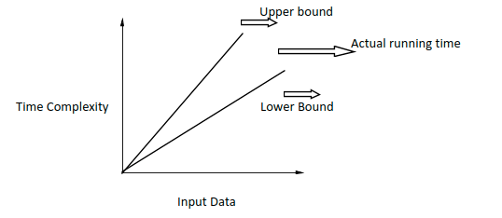
How to calculate f(n) or T(n)?
Let T(n) be a function that denotes the time complexity for an algorithm. Then, to find the value of T(n), we need to check for various values of n. Usually, finding the value of T(n) for smaller problems is easy as compared to the larger ones.

Slide 29
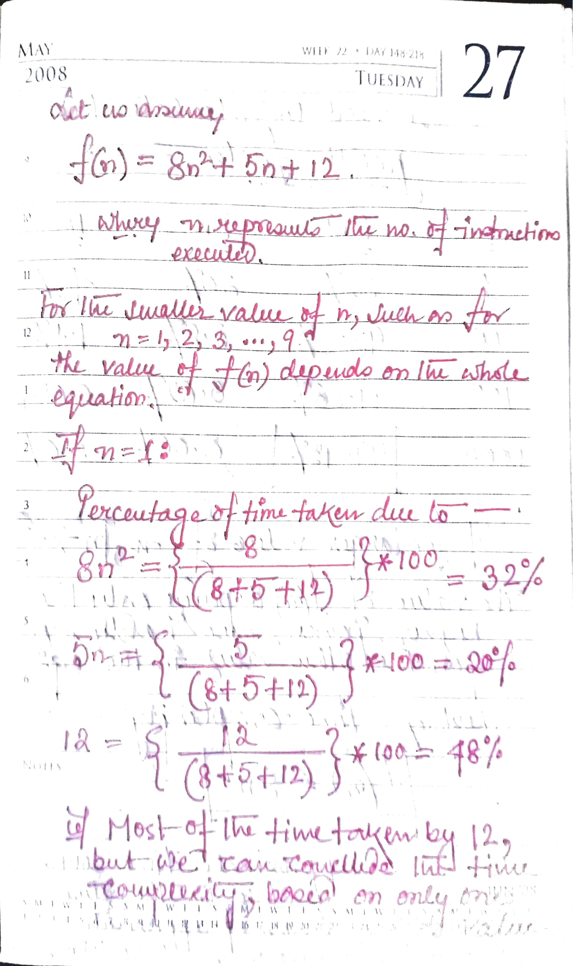
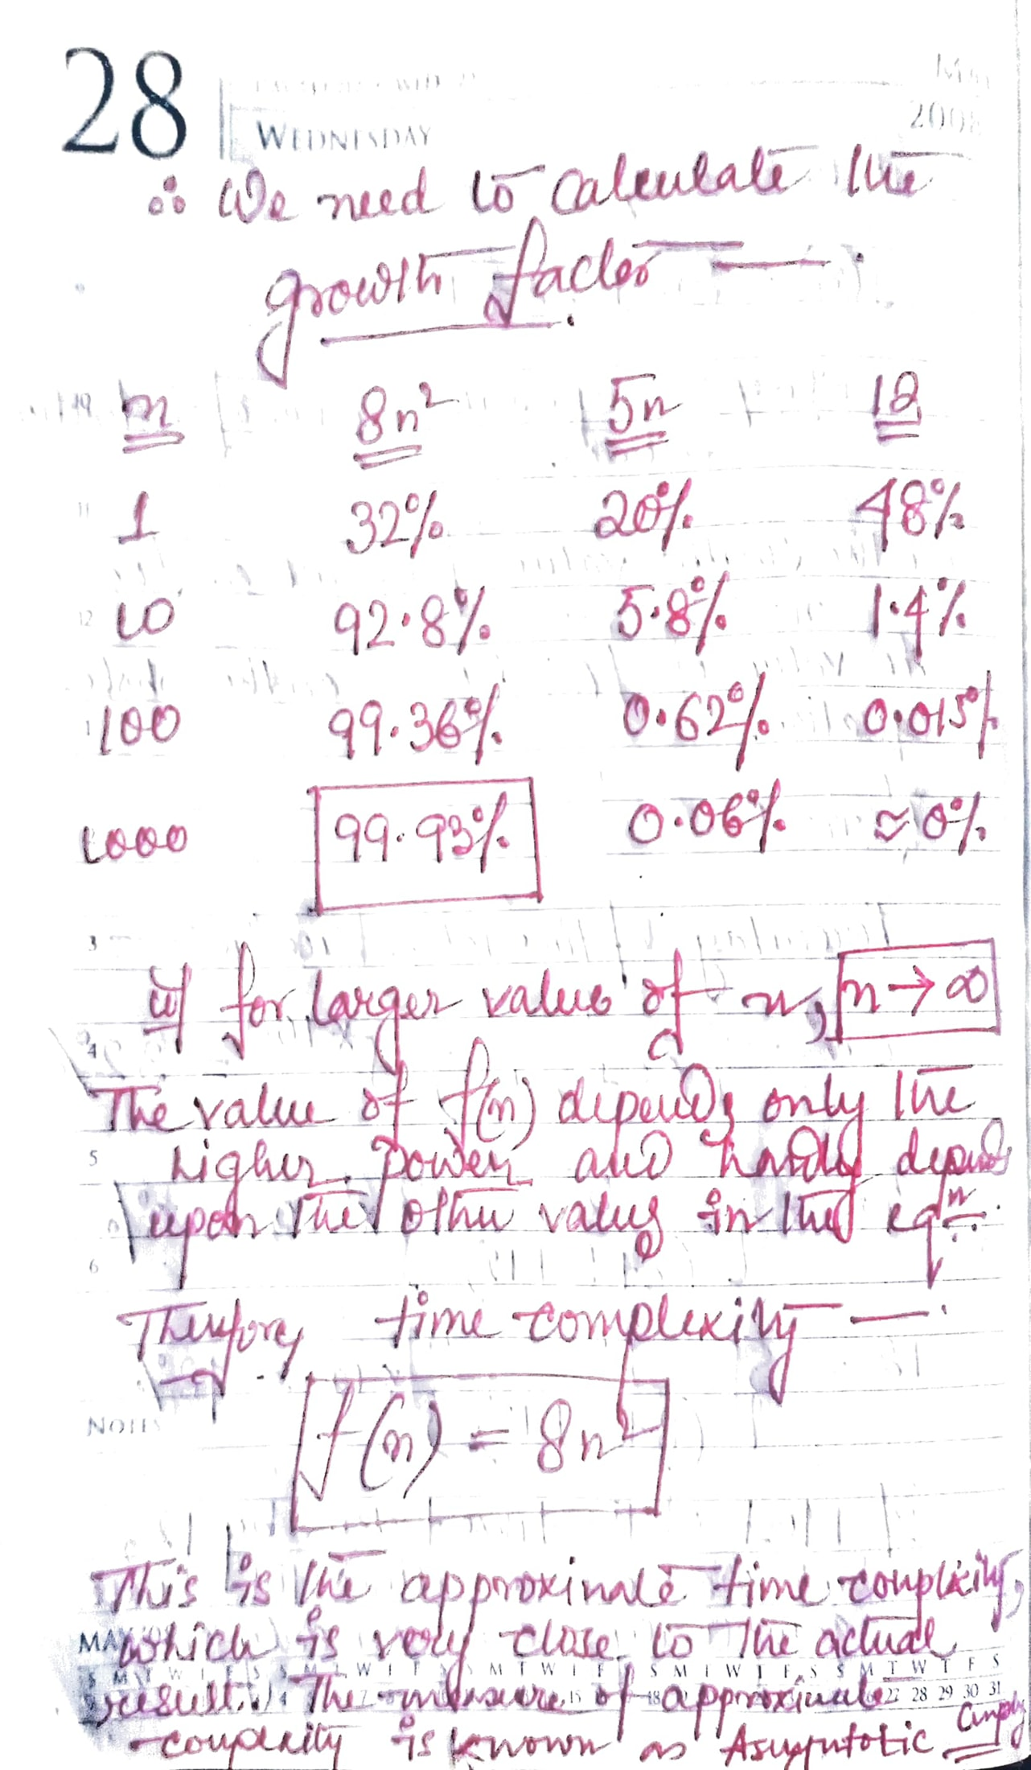

Slide 30
Asymptotic Notations:
The commonly used asymptotic notations used for calculating the running time complexity of an algorithm is given below -
Big oh Notation (O)
Omega Notation (Ω)
Theta Notation (θ)
The time required for the execution of an algorithm is categorized into three types:
Worst case: the maximum time required for the execution
Average case: average time taken for the execution.
Best case: minimum time taken for the execution.

Slide 31
Big oh Notation (O) -
Big O notation is an asymptotic notation that measures the performance of an algorithm by simply providing the order of growth of the function.
This notation provides an upper bound on a function which ensures that the function never grows faster than the upper bound.
So, it gives the least upper bound on a function so that the function never grows faster than this upper bound.
It is the formal way to express the upper boundary of an algorithm running time. It measures the worst case of time complexity or the algorithm's longest amount of time to complete its operation.

Slide 32
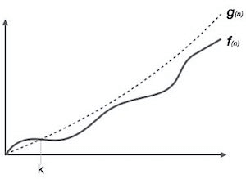
If f(n) and g(n) are the two functions defined for positive integers,
then f(n) = O(g(n)) as f(n) is big oh of g(n) or f(n) is on the order of g(n)) if there exists constants c and n_{o} such that:
f(n) ≤ c.g(n) for all n ≥ n_{o}
This implies that f(n) does not grow faster than g(n), or g(n) is an upper bound on the function f(n). In this case, we are calculating the growth rate of the function which eventually calculates the worst time complexity of a function, i.e., how worst an algorithm can perform.

Slide 33
Big Omega Notation (Ω) -
It basically describes the best-case scenario which is opposite to the big o notation.
It is the formal way to represent the lower bound of an algorithm's running time. It measures the best amount of time an algorithm can possibly take to complete or the best-case time complexity.
It determines what is the fastest time that an algorithm can run.
If we required that an algorithm takes at least certain amount of time without using an upper bound, we use big- Ω notation i.e. the Greek letter "omega". It is used to bound the growth of running time for large input size.
If f(n) and g(n) are the two functions defined for positive integers, then f(n) = Ω(g(n)) as f(n) is Omega of g(n) or f(n) is on the order of g(n)) if there exists constants c and no such that:
f(n) >= c.g(n) for all n ≥ n_{o} and c > 0

Slide 34
Big Theta Notation (θ) -
The theta notation mainly describes the average case scenarios.
It represents the realistic time complexity of an algorithm. Every time, an algorithm does not perform worst or best, in real-world problems, algorithms mainly fluctuate between the worst-case and best-case, and this gives us the average case of the algorithm.
Big theta is mainly used when the value of worst-case and the best-case is same.
It is the formal way to express both the upper bound and lower bound of an algorithm running time.
Let f(n) and g(n) be the functions of n where n is the steps required to execute the program then: f(n)= θg(n), The above condition is satisfied only if when -
c1.g(n) <= f(n) <= c2.g(n)

Slide 35
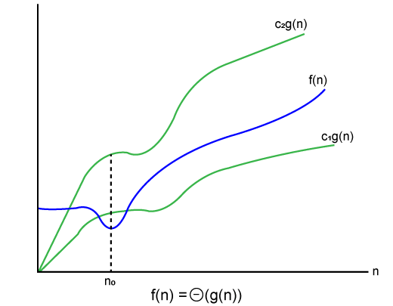
Where the function is bounded by two limits, i.e., upper and lower limit, and f(n) comes in between. The condition f(n)= θg(n) will be true if and only if c1.g(n) is less than or equal to f(n) and c2.g(n) is greater than or equal to f(n).

Slide 36
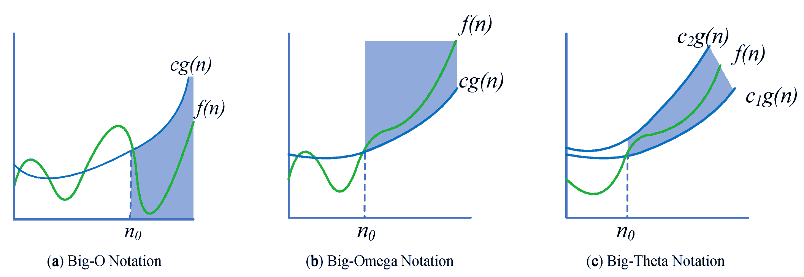
Comparative Graph Study of Algorithms
The constant terms can be ignored in the time complexity so average case would be θ(n).

Slide 37
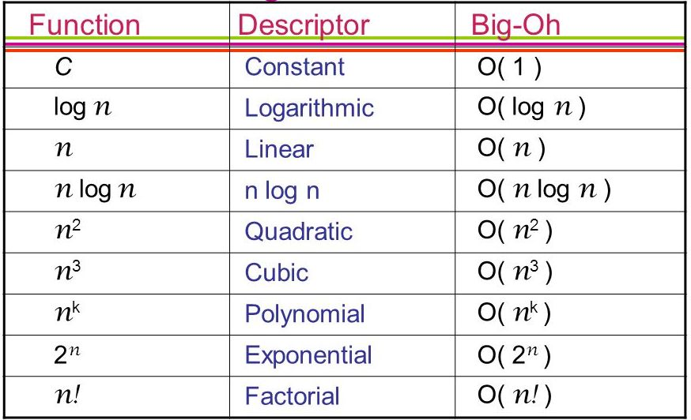

Slide 38
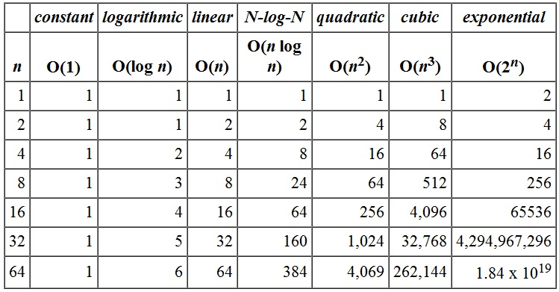

Slide 39
PseudoCode: Pseudo code refers to an informal high-level description of the operating principle of a computer program or other algorithm. It uses structural conventions of a standard programming language intended for human reading rather than the machine reading.
Advantages of pseudo code –
Pseudo code is understood by the programmers of all types.
It enables the programmer to concentrate only on the algorithm part of the code development.
It cannot be compiled into an executable program.
Disadvantages of pseudo code -
The visual representation of the programming code can be easily understood, and the pseudo code doesn't provide it.
There is no well-defined format to write the pseudo code.
There are no standards available for pseudo code. Companies use their own standards to write it.
If we use pseudo code, we need to maintain one more document for our code.

Slide 40
Difference between Algorithm and the Pseudo code -
An algorithm is simply a problem-solving process, which is used not only in computer science to write a program but also in our day to day life.
It is nothing but a series of instructions to solve a problem or get to the problem's solution.
It not only helps in simplifying the problem but also to have a better understanding of it.
Pseudo code is a way of writing an algorithm.
Programmers can use informal, simple language to write pseudo code without following any strict syntax.
It encompasses semi-mathematical statements.

Slide 41
Problem: Suppose there are 60 students in the class. How will you calculate the number of absentees in the class?
Algorithm Approach:
Initialize a variable called as Count to zero, absent to zero, total to 60
FOR EACH Student PRESENT DO the following:
Increase the Count by One
Then Subtract Count from total and store the result in absent
Display the number of absent students
Pseudo Code Approach:
Count <- 0, absent <- 0, total <- 60
REPEAT till all students counted
Count <- Count + 1
absent <- total - Count
Print "Number absent is:" , absent

